Slide 1
Electrical
and Electronics science
First year
Computer Science and Engineering
Dr. Shakti Singh
ASSISTANT PROFESSOR
ELECTRCIAL AND INSTRUMENATION
ENGINEERING DEPARTMENT
@shakti.singh@thapar.edu

Slide 2
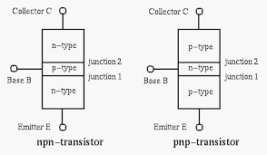
Introduction
Bipolar Junction Transistor (BJT) is a three terminal, three layered and two junction device.

Slide 3
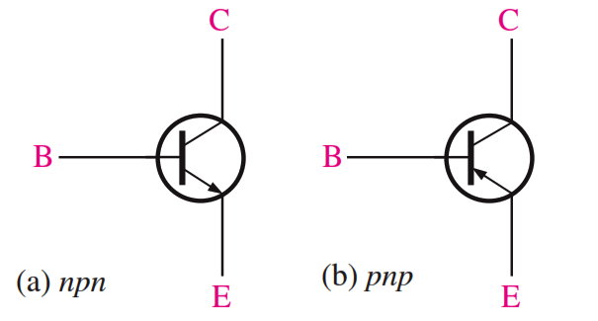
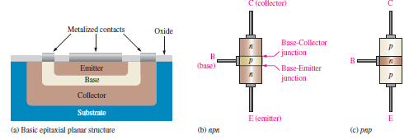
BJT-Construction
Emitter-Heavily Doped
Collector-Moderately doped
Base-Lightly doped (Very thin)

Slide 4
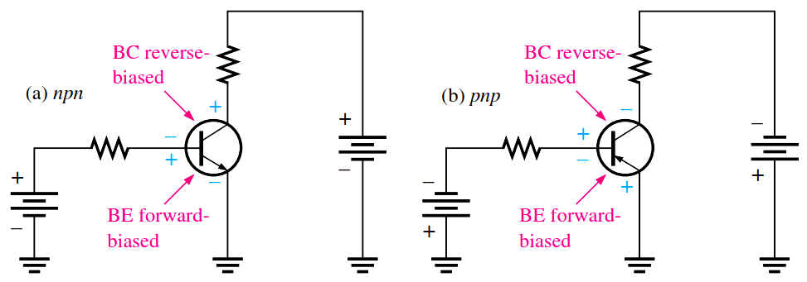
BJT-Biasing
Biasing is to provide correct external dc voltage to make the transistor work.
Biasing arrangement for BJT as an amplifier. BE→ Fwd, BC→ Rev

Slide 5
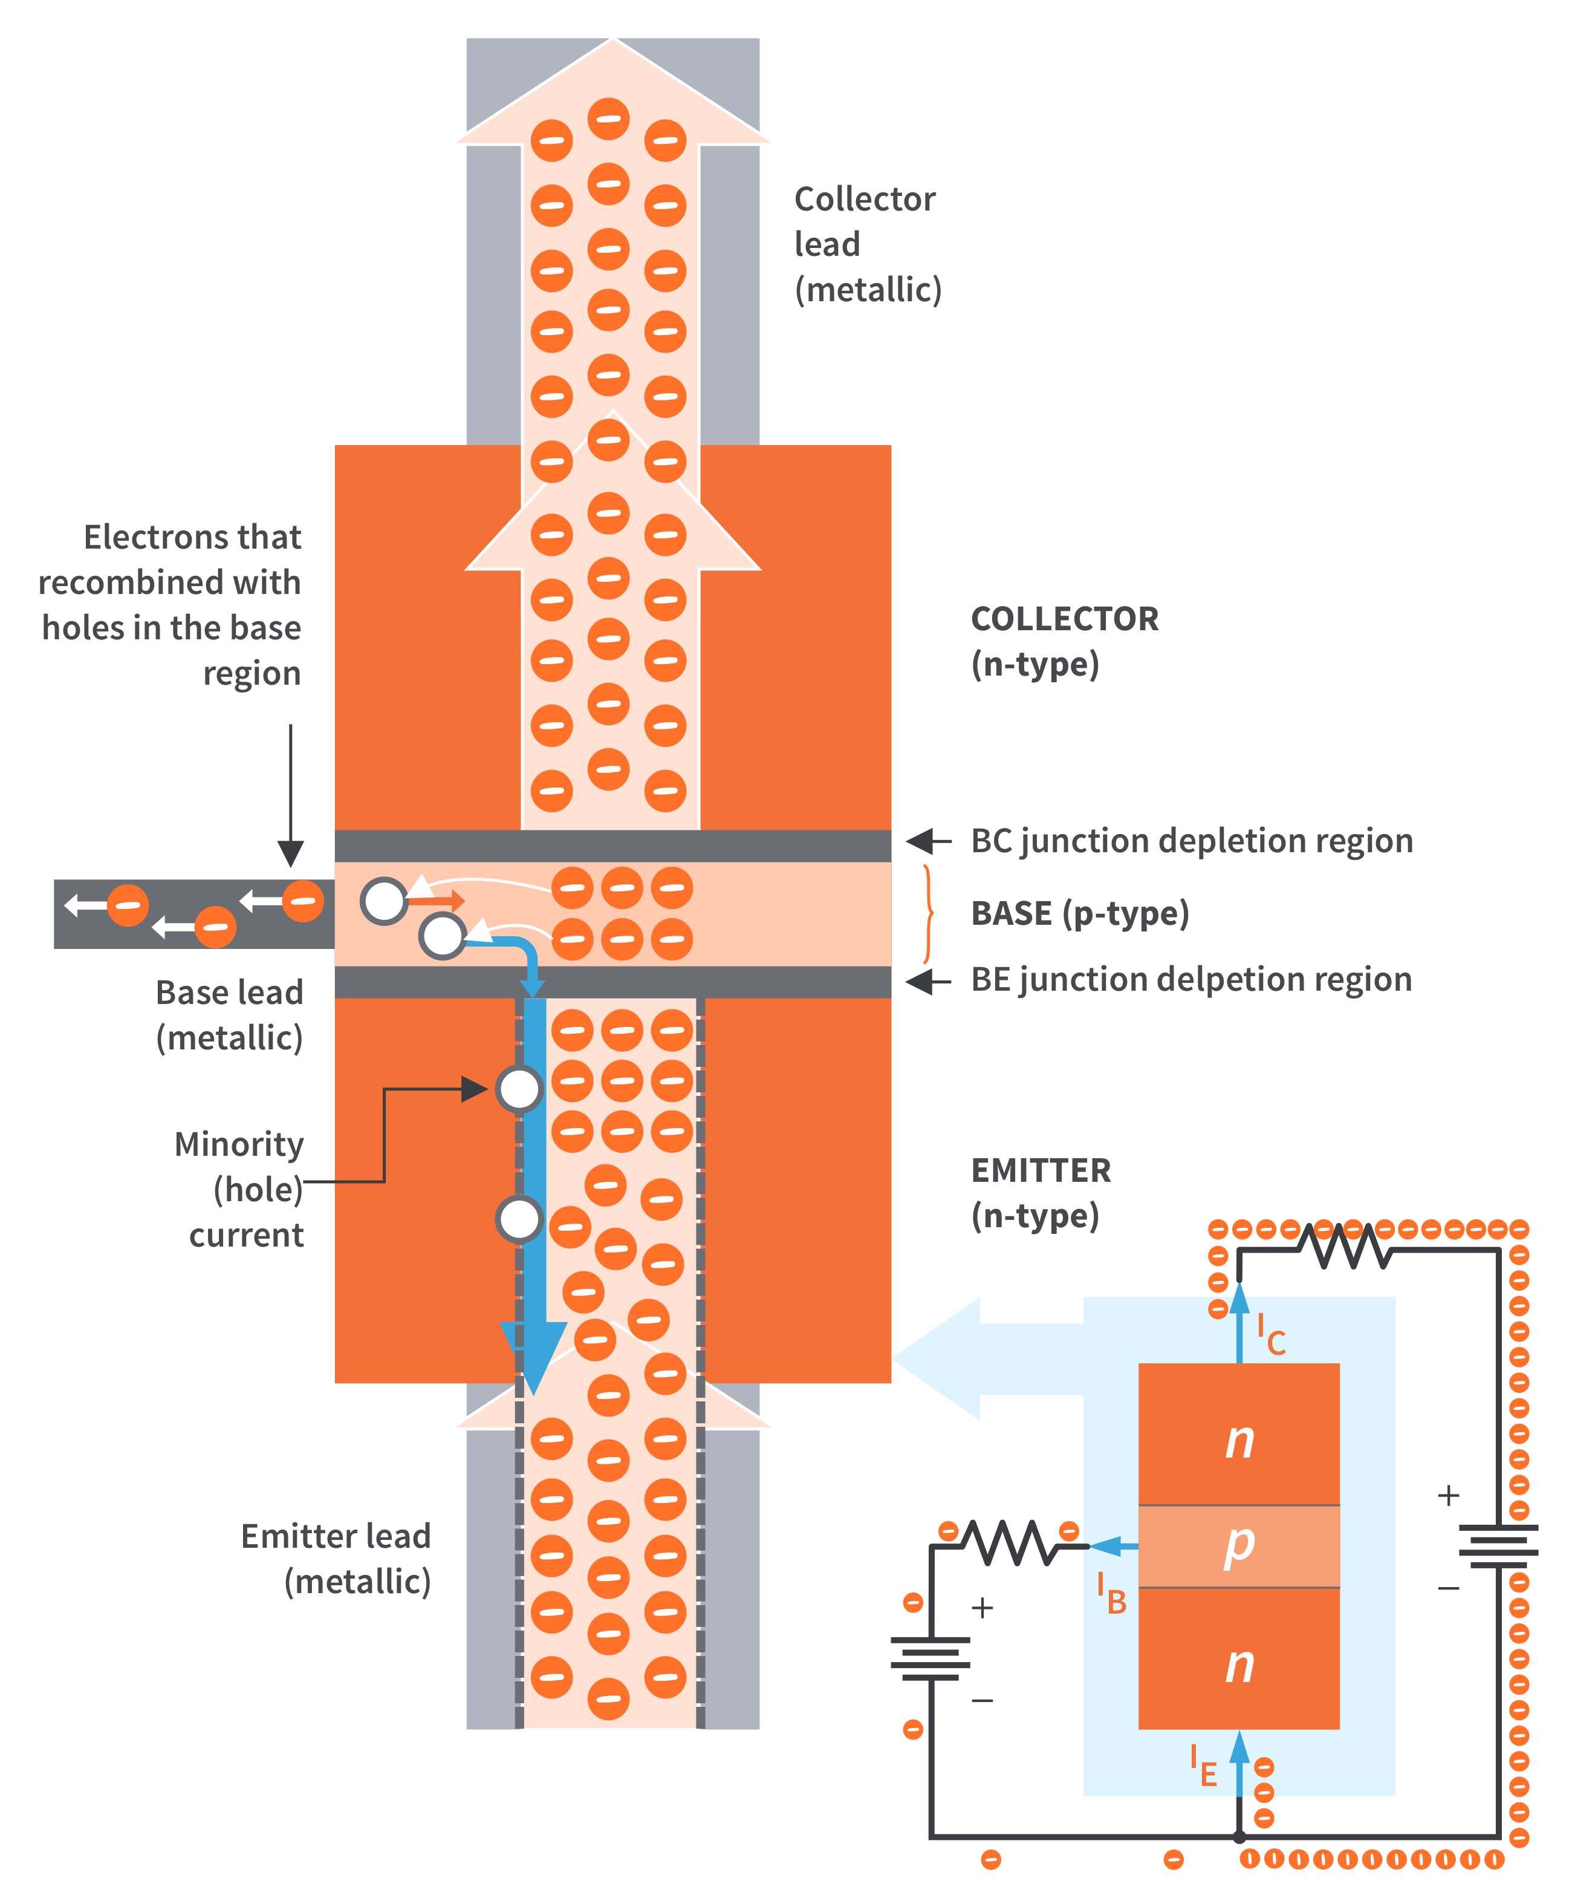
BJT Operation
BE junction is forward-biased → free electrons from the emitter region easily cross the base-emitter junction and go into the very thin and lightly doped p-type base region.
The p-type base region is just lightly doped, it doesn’t have that many holes in it.
Small percentage of the free electrons from the emitter region can recombine with the holes in the base region. → Base Current (I_{B})
The free electrons that entered the base region but didn’t recombine with the holes move toward the reverse-biased BC junction.
Since the collector region is connected to the positive side of the external bias voltage, the free electrons are attracted to the positive side and are swept across into the collector region.
I_{E}=I_{C}+I_{B.}

Slide 6
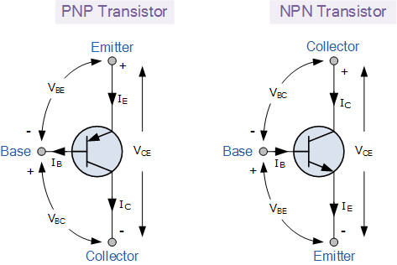
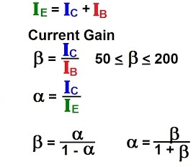
Transistor Currents
I_{E}=I_{C}+I_{B.}
Alpha and Beta Current Gain.

